Slide 1
for Laurie
Note that the animations in the slides here work for ppt but might not work in your freebie, cheapo, shareware version of ppt – so first few slides will look a bit cluttered when not animated

Slide 2


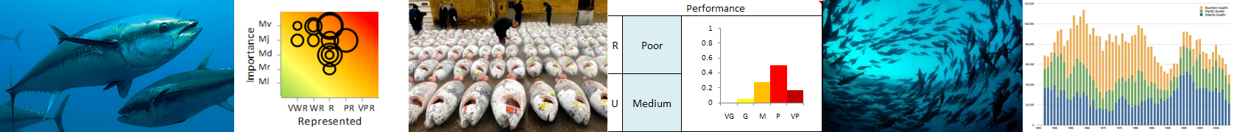
Preliminary assessment of uncertainties in GBYP Identifying risks and their relative importance
Adrian Leach, John Mumford, Polina Levontin, John Holt, Laurie Kell
01/05/2012

Slide 3
Bluefin tuna MSE problem
Problem:
BFT rebuilding plan stochastic projections do not capture all the uncertainty associated with assessment/management
Modelled outcome is likely to be more optimistic than reality
Stakeholder based approach
Visual tools to help ICCAT scientists negotiate a consensus
Evaluate degree of consensus among stakeholders
Identify the main sources of uncertainty
Provide preliminary quantification of relative importance
Model based approach
Specify scenarios for OM in MSE
Evaluate uncertainty by redoing assessment
Elasticity analysis for continuous variables

Slide 4
Stakeholder Questionnaire Three dimensions of variables: five point scales
Importance of variable
“How big is the potential impact on the success of achieving management objectives?” Minimal, Minor, Medium, Major, Massive
Available knowledge uncertainty
“What is the scale of the knowledge uncertainty in the variable?” Very Low, Low, Medium, High, Very High
Represented currently
“To what extent a given source of uncertainty is already taken into account in the assessment?” Very Well to Very Poorly Represented

Slide 5
Visualisation: Colour and sizes provide a relative view, not linked to specific risk preferences/judgements
Size of bubble shows Uncertainty rating. This small bubbles denote Low Uncertainty.
Larger bubbles denote higher levels of Uncertainty.
This axis shows the Importance dimension on a scale of Minimal (Ml) to Massive (Mv)
This axis shows how well the variable (and its uncertainty) is represented in the current assessment. Very Well Represented (VWR) to Very poorly represented or not at all (VPR)

Slide 6
Extremes
Lowest risk variable
Minimal importance; Very well represented in the assessment; Very low uncertainty. Not a common case, we suspect! The Bubble occupies the bottom-left green zone.
Highest risk variable.
Massive importance; Very poorly represented in the Assessment; High uncertainty. A high priority variable. The Bubble occupies the upper-right red zone.

Slide 7
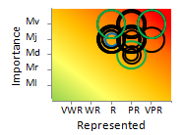
Examples of real results: Environmentally driven recruitment variability and density dependence Fairly Good consensus on High Importance; Fairly Good consensus on Uncertainty; Fairly Good consensus on Representation in current assessment
Black hoops: Scientists; Green: NGOs; Blue: Managers

Slide 8
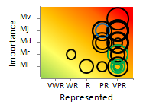
Interactions with other species Poor consensus on Importance; Poor consensus on Uncertainty; fairly Good consensus in Representation in current assessment
Black hoops: Scientists; Green: NGOs; Blue: Managers

Slide 9
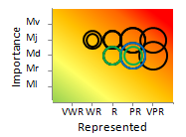
Stationarity, cohort year effects, density dependence Good consensus on Importance; Good consensus on Uncertainty; Poor consensus in Representation in current assessment
Black hoops: Scientists; Green: NGOs; Blue: Managers

Slide 10
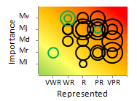
Risk attitudes of managers No consensus in any dimension
Black hoops: Scientists; Green: NGOs; Blue: Managers

Slide 11
Top 21 Uncertainties
Panel of 5 scientists (4 governmental and 1 NGO) applied Importance ratings to each to the uncertainties
Panel discussion
Cross referenced with All stakeholder hoop charts
Choices challenged and clarified by an elicitor
Following slides show ratings for the top 21 uncertainties (rated as either Massive or Major Importance by panel)
Each slide shows the Uncertainty name, All stakeholder hoop for each and the method by/role which the uncertainty could be included in future assessment

Slide 12
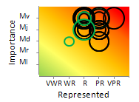
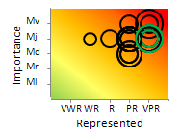
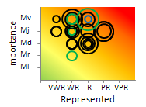
Massive importance 1 – Focus group consensus
 | All stakeholders | Modelling
Catch under-reporting - in particular of juvenile catch in artisinal fisheries |  | F ages 0-3
Variability in migration patterns |  | OM
Management objectives

Slide 13
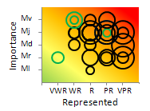
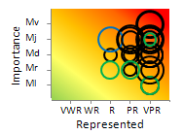
Massive importance 2 – Focus group consensus
 | All stakeholders | Modelling
Risk attitudes of managers |  | OM
Social impacts of regulations and its affect on small local communities |  | OM

Slide 14
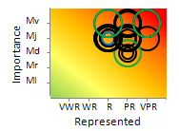
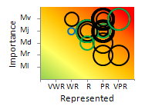
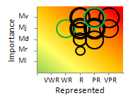
Major Importance (1) – Focus group consensus
 | All stakeholders | Modelling
Environmentally driven recruitment variability and density dependence |  | Low, Median, and High steepness scenarios
Natural mortality at age, variability, age related senescence |  | M=.2, exp(-x), bathtub
Steepness (meta-analysis) |  | 0.6, 0.75, 1

Slide 15
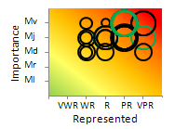
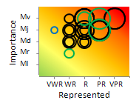
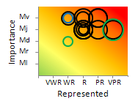
Major Importance (2) – Focus group consensus
 | All stakeholders | Modelling
Model complexity
Standardisation across gear, countries, areas and time |  | Redo assessment
Generation of age data, age-length keys, slicing |  | Redo assessment

Slide 16
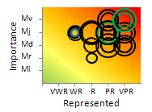
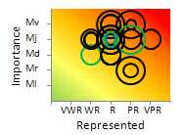
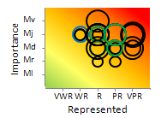
Major Importance (3) – Focus group consensus
 | All stakeholders | Modelling
Migration between ICCAT agreed stock units |  | OM
Maturation and fecundity |  | Mat and SRP
Changes in regulations translating into changes of fishing practices |  | OM

Slide 17
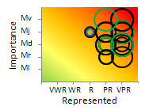
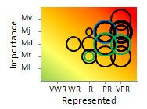
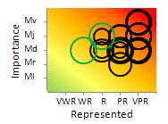
Major Importance (4) – Focus group consensus
 | All stakeholders | Modelling
Environmental factors that influence migration patterns |  | OM
Complexity of tuna habitat |  | OM
Ecological\environmental (other than climate change) potential to change population dynamics |  | Fcrash/MBAL

Slide 18
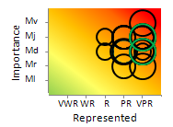
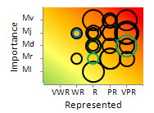
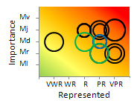
Major Importance (5) – Focus group consensus
 | All stakeholders | Modelling
Climate change and/or increased variability's potential to change population dynamics |  | Mat and SRP
Spawning, periodicity, aggregation and location of spawning areas |  | OM
Group dynamics, skipped- spawning, density dependence |  | OM

Slide 19
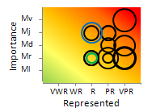
Major Importance (6) – Focus group consensus
 | All stakeholders | Modelling
Impacts of regulations and its effect on the species' apparent global distribution. |  | OM

Slide 20
Plans
Based on stakeholder/focus group results, the list of uncertainties was made to guide operating/assessment model development
Elasticity analysis and scenario analysis will be made for several variables to quantify the sensitivity of the O/A model
Other identified hypothesis will be newly included and explored in the OM
The results of these analysis will be used to develop a procedure for reporting to decision makers/stakeholders the relative degree of confidence that should be placed in various models.

Slide 21
Conclusion
The aim is to develop a step-wise generic process by which trust in the models can be measurably improved by including important uncertainties
Stakeholder beliefs and reservations are elicited
The list is analyzed and prioritized according to consensus opinion
Key uncertainties are model tested/quantified
Results are communicated in such a way that it is clear to what extent all the factors that are deemed relevant by stakeholders are accounted for in model-based conclusions

